Slide 1

University of Central Florida COP 3330 Object Oriented Programming

Slide 2
Agenda
Administrative
Software Development Lifecycle 3.0

Slide 3
Instructor
Instructor
Karin Whiting
Office location: HEC 412
Office hours
Monday, Wednesday, Friday @ 10:00 A.M. – 12:00 P.M.
Monday, Wednesday @ 2:00 – 4:00 P.M.
Email:
Please contact me via Webcourses

Slide 4
Teaching Assistants
Teaching Assistant
William Funk
Email: funk@ucf.edu
Teaching Assistant
Awrad Mohammad Ali
Email: award.emad@knights.ucf.edu
Teaching Assistant
Tuoerhongjiang Yusufu
Email: turgan@knights.ucf.edu
Teaching Assistant
Jun Xu
Email: junxu@knight.ucf.edu

Slide 5
Supplemental Instruction
SI Leader
John
OPAL hours (online):
Monday/Wednesday: 5:00 – 5:50 PM
https://ucf.adobeconnect.com/cop3330-object-oriented-programming-fall2015
https://goo.gl/Q7zix4
1. To enter a session, they should log in as a GUEST.
2. They will be prompted for a name. They should enter their first and last names.
3. Password (cASE-SenSiTive): OPAL

Slide 6
Supplemental Instruction
SI Leader
John
Day | Time | Room
Monday | 10:30 AM- 11:20 AM | CB1 307
Monday | 2:30 PM- 3:20 PM | CB1 318
Monday | 5:00 PM- 5:50 PM | Online
Wednesday | 5:00 PM- 5:50 PM | Online
Friday | 3:30 PM- 4:20 PM | CB1 107

Slide 7
SDLC 3.0

Slide 8
SDLC 3.0
Reference
Kennaley, M. (2010). SDLC 3.0: Beyond a Tacit Understanding of Agile. Fourth Medium Consulting, Inc. ISBN: 978-0-9865194-0-6

Slide 9
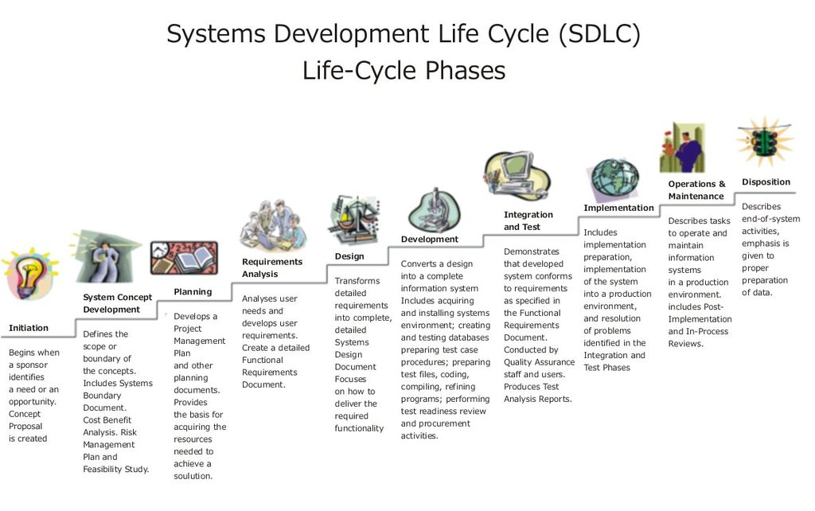
SDLC 3.0

Slide 10
Why software projects fail
Based on IEEE, the most common factors:
Unrealistic or unarticulated project goals
Inaccurate estimates of needed resources
Badly defined system requirements
Poor reporting of the project's status
Unmanaged risks
Poor communication among customers, developers, and users
Use of immature technology
Inability to handle the project's complexity
Sloppy development practices
Poor project management
Stakeholder politics
Commercial pressures

Slide 11
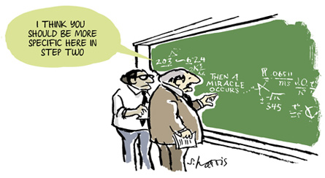
The Miracle!

Slide 12
Subset of SDLC Concepts
Waterfall: Building a piece of software one step at a time, from full specs to full code to full test. It’s one-way, analog, rigid and old-fashioned.
Agile: Building software in a series of sprints that let you adjust along the way.
Brooks’ Law: When a product is crashing, burning and delayed, throwing more people at it only makes crash harder, burn faster, an be more delayed (i.e. have a baby in one month with nine people).
The Standish Group – A research firm that collects data on software project failures. Hint: Success is rare.

Slide 13
Modern Software Engineering
Iterative/Incremental Development
Iterations provide a mechanism to facilitate learning from frequent demonstrations of working software (i.e. increments)
Serve as a measure of progress which implies scope of completion
Early and more frequent test engagement
Focus on the primary artifact, working software
Delivery of value occurs as fast as possible
IT can yield the highest productivity with efficiency and effectiveness
Waste aversion
Waste results from activities that add cost without adding value

Slide 14
Modern Software Engineering
Adaptive management
Requirements form the direction of a project but are likely to be flawed and subject to change
The project needs to be steered along the optimum path relative to resource utilization
Customer collaboration
What are the customers’ wants and needs?
Well formed requirements are
Understandable
Unambiguous
Precise
Concise
Testable

Slide 15
Modern Software Engineering
Openness, visibility, and learning
Continual improvement through learning
Utilize visibility of concrete results of tested working software
Open workspaces, pairing, and visible charts establish a high-trust culture between customer and delivery team
Reduction of complexity
Complexity is one of the leading cost drivers in software economics
Visual modeling attempts to reduce complexity

Slide 16
Agile
Building software in a series of sprints that let you adjust along the way
Time-boxing
Product backlog
Burn-down and Velocity
Co-location
Self organizing teams
Continuous integration and release
Pairing
Test driven development

Slide 17
Agile Manifesto
Agile Manifesto was published in 2001 as a result of what was wrong with the state of Software Engineering
We are uncovering better ways of developing software by doing it and helping others do it. Through this work we have come to value:
Individuals and interactions over processes and tools
Working software over comprehensive documentation
Customer collaboration over contract negotiation
Responding to change over following a plan
That is, while there is value in the items on the right, we value the items on the left more

Slide 18
12 Principles of Agile Software
Principles behind the Agile Manifesto
Our highest priority is to satisfy the customer through early and continuous delivery of valuable software.
Welcome changing requirements, even late in development. Agile processes harness change for the customer's competitive advantage.
Deliver working software frequently, from a couple of weeks to a couple of months, with a preference to the shorter timescale.
Business people and developers must work together daily throughout the project.

Slide 19
12 Principles of Agile Software
Principles behind the Agile Manifesto
Build projects around motivated individuals. Give them the environment and support they need, and trust them to get the job done.
The most efficient and effective method of conveying information to and within a development team is face-to-face conversation.
Working software is the primary measure of progress.
Agile processes promote sustainable development. The sponsors, developers, and users should be able to maintain a constant pace indefinitely.

Slide 20
12 Principles of Agile Software
Principles behind the Agile Manifesto
Continuous attention to technical excellence and good design enhances agility.
Simplicity--the art of maximizing the amount of work not done--is essential.
The best architectures, requirements, and designs emerge from self-organizing teams.
At regular intervals, the team reflects on how to become more effective, then tunes and adjusts its behavior accordingly.

Slide 21
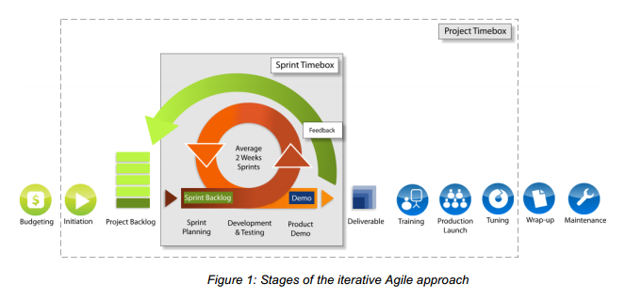
Agile
Time-boxing
Creates a project environment that strives for creating a natural rhythm for delivery of value through tension and pressure

Slide 22
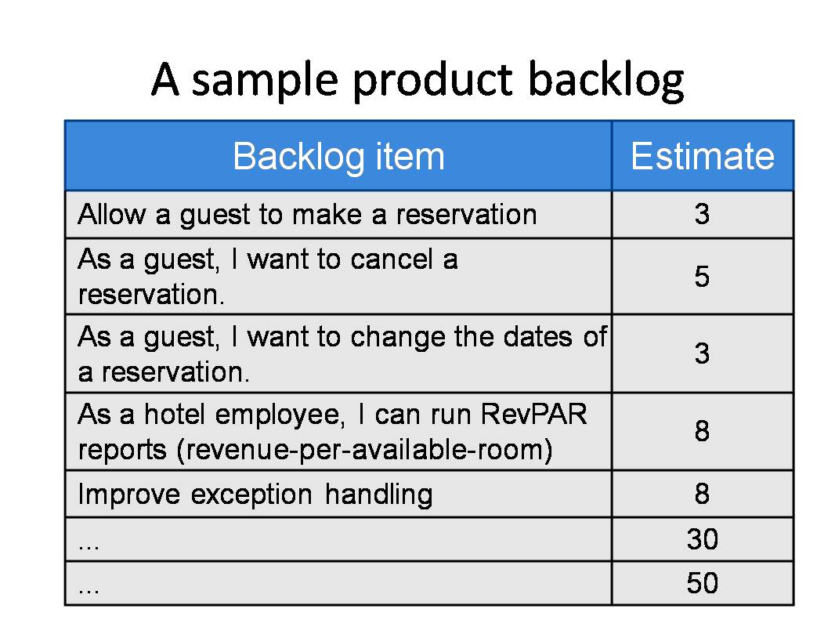
Agile
Product backlog
Based on the concept of queueing
Constantly reprioritizes product requests

Slide 23
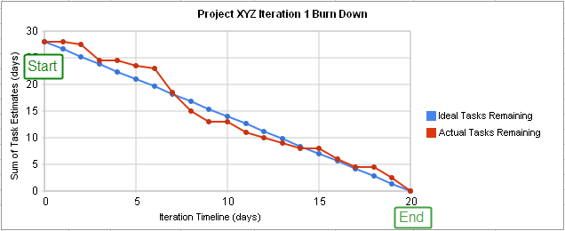
Agile
Burn-down and Velocity
Derivative of scope to determine progress

Slide 24
Agile
Co-location
The logistical difficulty with moving members across geographies brings resistance
Collocated teams work in a “war room” (i.e. commons)
Separated offices or cubicles (i.e. caves) are areas team members can work in quiet times
Distribution which requires follow-the-sun or offshore strategies is difficult to integrate
Communication effectiveness:
Words: 7%
Voice: 38%
Visual: 55%

Slide 25
Agile
Self organizing teams
Software engineering practice where the software development team can continue to function in the absence of the Project Manager
A member of the software development team assumes leadership, typically known as the ScrumMaster, this is the person who leads the Scrums
A Scrum is framework for managing product development an occurs on a recurring basis to discuss the individual software developer progress

Slide 26
Agile
Continuous integration and release
Key concept is to integrate and test early and often
Daily builds of the application
A build is compiling all of the source code of an application to generate an executable product (i.e. when a developer compiles their source code they are building it)
Typically unit testing is performed as part of the build process
Unit testing will be discussed in another lecture
Build errors result in a broken build until the software defects are resolved

Slide 27
Agile
Pairing
Popularized by Extreme Programming
Two developers sit together sharing physical resources and take turns developing software
The developer typing is the driver
The developer watching is the reviewer providing real-time code review
Also known as shared code ownership

Slide 28
Agile
Test driven development
Developers design unit test prior to writing code
As opposed to functional or acceptance tests
Unit tests are typically developed using unit test harness tools
In Java we use Junit
Unit tests are performed every time code is checked in to a source code repository
Subversion
CVS
Microsoft Team Foundation Server

